Slide 1

Technology Focus:
Integrating COTS Devices with EPICS
Ralph Lange, ITER Organization

Slide 2
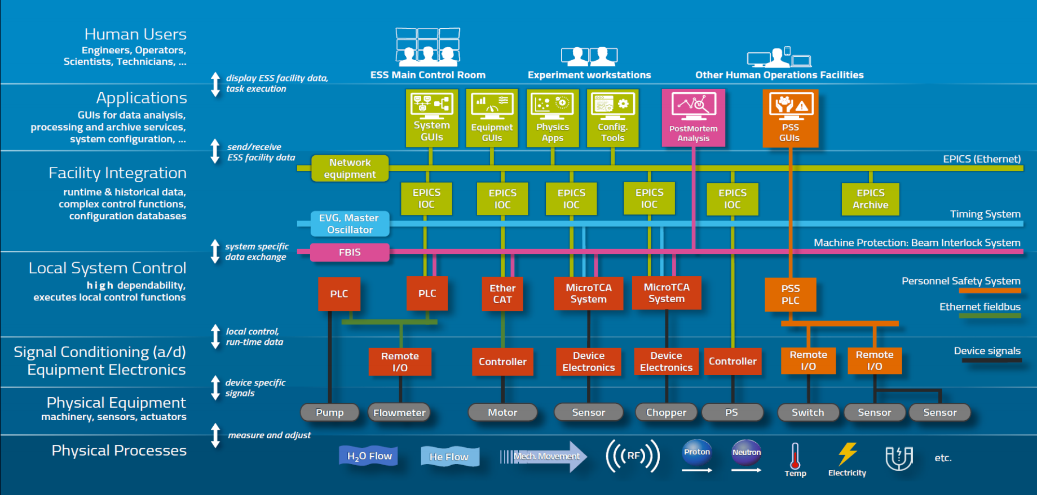
Context: EPICS IOCs in the Integration Layer

Slide 3
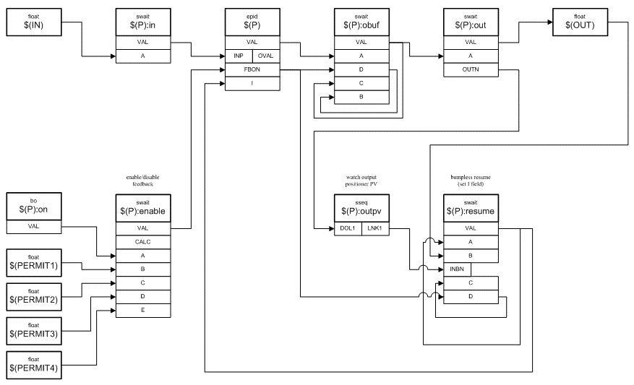
Context: Device Support – Connecting Records to Hardware
EPICS IOC
PVA & CA Network Servers
EPICS clients connect using the pvAccess and Channel Access network protocols
Configurable interconnected objects (records ) provide flexibility and functionality
Records that represent I/O channels use the Device Support layer to connect to hardware
EPICS Process Database
Device Support Modules

Slide 4

Choices are: Standards or Flexibility
One of the EPICS principles: Configuration over Coding
1 – Use a rich high-level communication standard
Rich standard covers everything you would ever need
On-the-wire protocol: standard
Shifts integration effort to the device
2 – Use a low-level communication abstraction with a flexible configuration
Transport of messages is handled by fixed (coded) parts
Content of messages is handled by a configurable engine
On-the-wire protocol: device specific
Shifts integration effort to the IOC (message engine configuration)
Two examples:
StreamDevice

Slide 5
1 – OPC UA: Interfacing SCADA to Controllers (PLCs)
Industrial standard (2006) to interface controllers
Covers data, alarms, events, historical data, remote methods
Symbolic addressing
Browsable
Based on OPC Classic (Microsoft, 1996), adding
Portability
WAN Support (TCP instead of DCOM)
Safety/security (certificate-based authentication and encrypted connection)
Information modeling (user-defined structures)
Gaining momentum as universal integration standard
Some controllers (e.g., Siemens S7-1500 series PLCs) offer an embedded OPC UA server

Slide 6
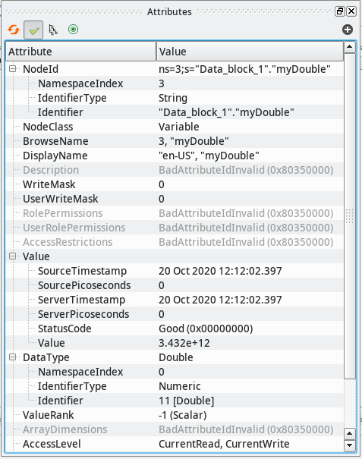
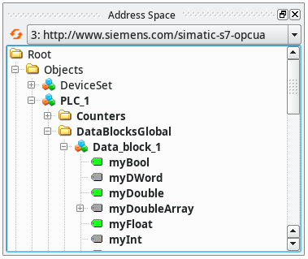
1 – OPC UA: Integration Workflow
Step 1: Browse the server to find the interesting things
Free browsing tool: UaExpert

Slide 7
1 – OPC UA: Integration Workflow
Step 2: Configure the IOC by connecting to the OPC UA server from the startup script...
    opcuaCreateSession PLC1 opc.tcp://plc1.controls.local:4840
    opcuaCreateSubscription SUB1 PLC1 200
...and adding an EPICS record to your database
    record(ai, "$(DEVICE):dbl1") {
    field(DTYP, "OPCUA")
    field(INP, "@SUB1 ns=3;s=\"Data_block_1\".\"myDouble\"")
    field(PREC, "3")
    }

Slide 8
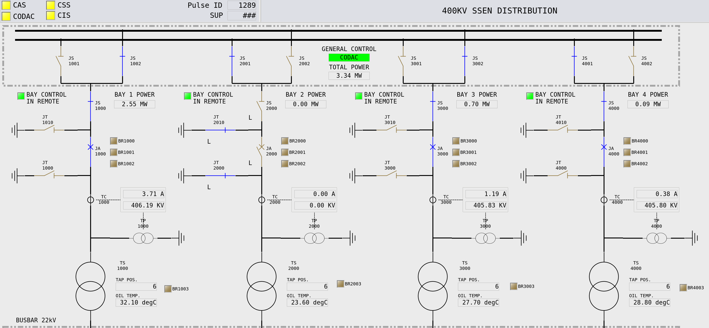
1 – OPC UA: Integration Workflow
Step 3: Design your client applications and connect

Slide 9




Other Communication Standards Supported by EPICS
OPC Classic
Predecessor (subset) of OPC UA; Windows only; local network only
EtherCAT
Ethernet based fieldbus technology
Real-time capability (deterministic)
MODBUS
Often used to integrate remote I/O suited for PLCs directly into an EPICS IOC
BACnet
Standard used in Building Automation and Control:
HVAC, lighting, cooling water, fire detection

Slide 10
2 – StreamDevice: Request/Response Done printf/scanf Style
Abstraction of request/response style communication over streaming transport
EPICS Device Support (for all standard record types) by Dirk Zimoch / PSI
Uses the ASYN framework to provides a common „byte stream“ type interface to everything serial:
RS-232, RS-485, IEEE-488 (GPIB), TCP, UDP
Run-time protocol engine that handles the content going over the wire
ASCII configuration file defines a set of request/response pairs (protocols)
Values are formatted and parsed through printf/scanf type format converters
(also supporting hex, raw byte, BCD, different checksums, regular expressions,...)
Most common EPICS method to integrate „String over TCP“ devices
Hundreds of protocol files exist, mostly available „on demand“ through Tech-Talk
StreamDevice

Slide 11
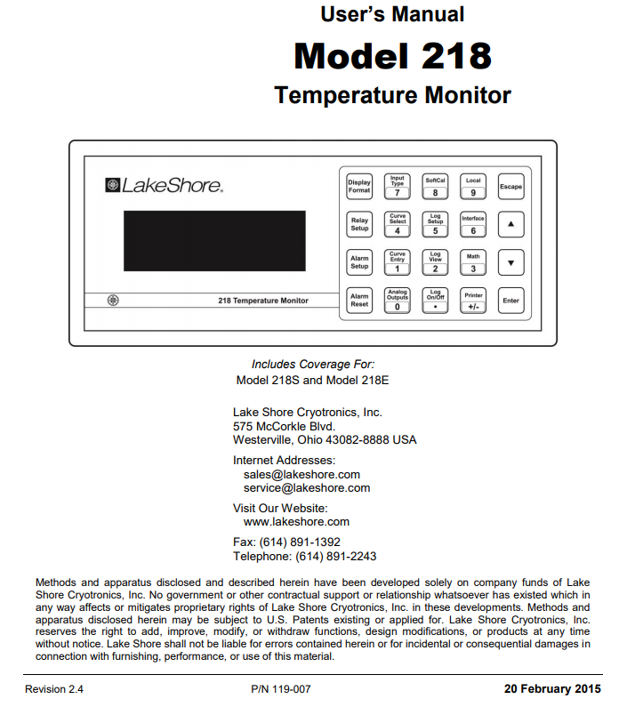
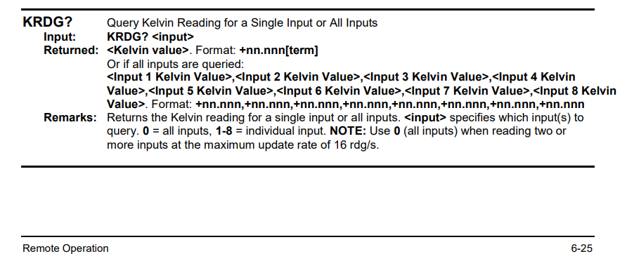
2 – StreamDevice: Integration Workflow
Step 1: Read the friendly manual

Slide 12
2 – StreamDevice: Integration Workflow
Step 2: Add a protocol to the protocol file for your device (e.g., LS218.prot)
      ...
      temp_K_1 {
      out "KRDG? 1";
      in "%f";
      }
      ...

Slide 13
2 – StreamDevice: Integration Workflow
Step 3: Configure the IOC by connecting to the device from the startup script...
    drvAsynSerialPortConfigure "LakeShore1", "/dev/ttyS0"
    asynSetOption "LakeShore1", 0, "baud", "9600"
    asynSetOption "LakeShore1", 0, …
...and adding an EPICS record to your database
    record (ai, "$(DEVICE):TEMP1") {
    field (DTYP, "stream")
    field (INP, "@LS218.prot temp_K_1 LakeShore1")
    field (EGU, "K")
    field (PREC, "2")
    }

Slide 14
2 – StreamDevice: Integration Workflow
Step 4: Design your client applications and connect
These PVs could also be connected by StreamDevice:
Clients connect to the EPICS process database – the behavior stays the same.
But they are using OPC UA, really.

Slide 15
Considerations for Any Specific Device
Rich high-level communication standard (e.g., OPC UA)
High effort on the device controller
Development: all adaptation is done on the controller, extensive testing necessary
Run-time: needs considerable CPU resources on the controller
One job for all
Many SCADA systems will be able to integrate the device (not just EPICS)
Low-level byte stream request/response communication (StreamDevice)
Interface needs to be well-defined, well-documented and stable
Incompatible changes will break all integrations (not just EPICS)
Use regular communication patterns and keep the commands stateless
Optimal vendor-supplied EPICS Integration:
Protocol file and matching simple test application (names and screens will not be used)
Device emulator (e.g., Python script) to support automated testing w/o hardware

Slide 16
Conclusion
EPICS can integrate COTS devices using generic Device Support modules implementing high levels of standardization and/or flexibility.
Such approaches allow interfacing many different devices by different vendors without coding or recompilation, by configuring the EPICS Process Database appropriately.
Device vendors can ease EPICS integration of their devices by following standards and good practices. Companies providing EPICS consulting can help you.
Thank you for your attention.

